Slide 1
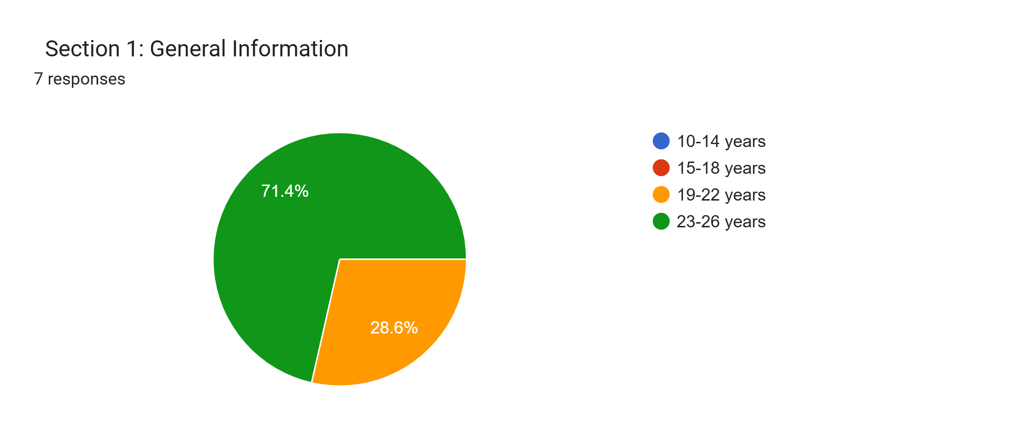
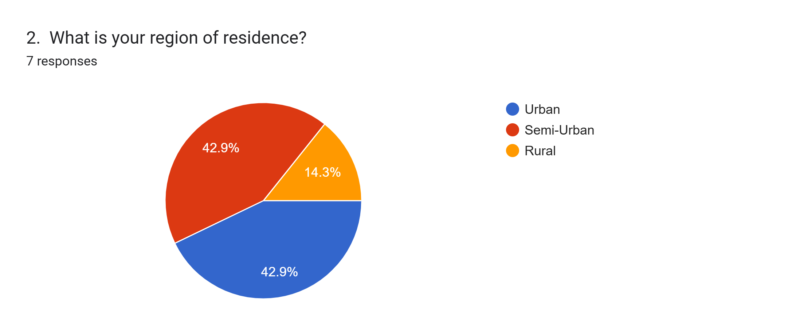
Title: COVID-19 and Its Impact on Students
Subtitle: Exploring the Effects on Education, Social Life, and Mental Health
Key Details :
Total Responses: 7
Survey Focus:
Impact on Education
Social Life
Mental health
Number of Questions: 20
Format: Divided into 4 sections for better clarity and analysis.

Slide 2
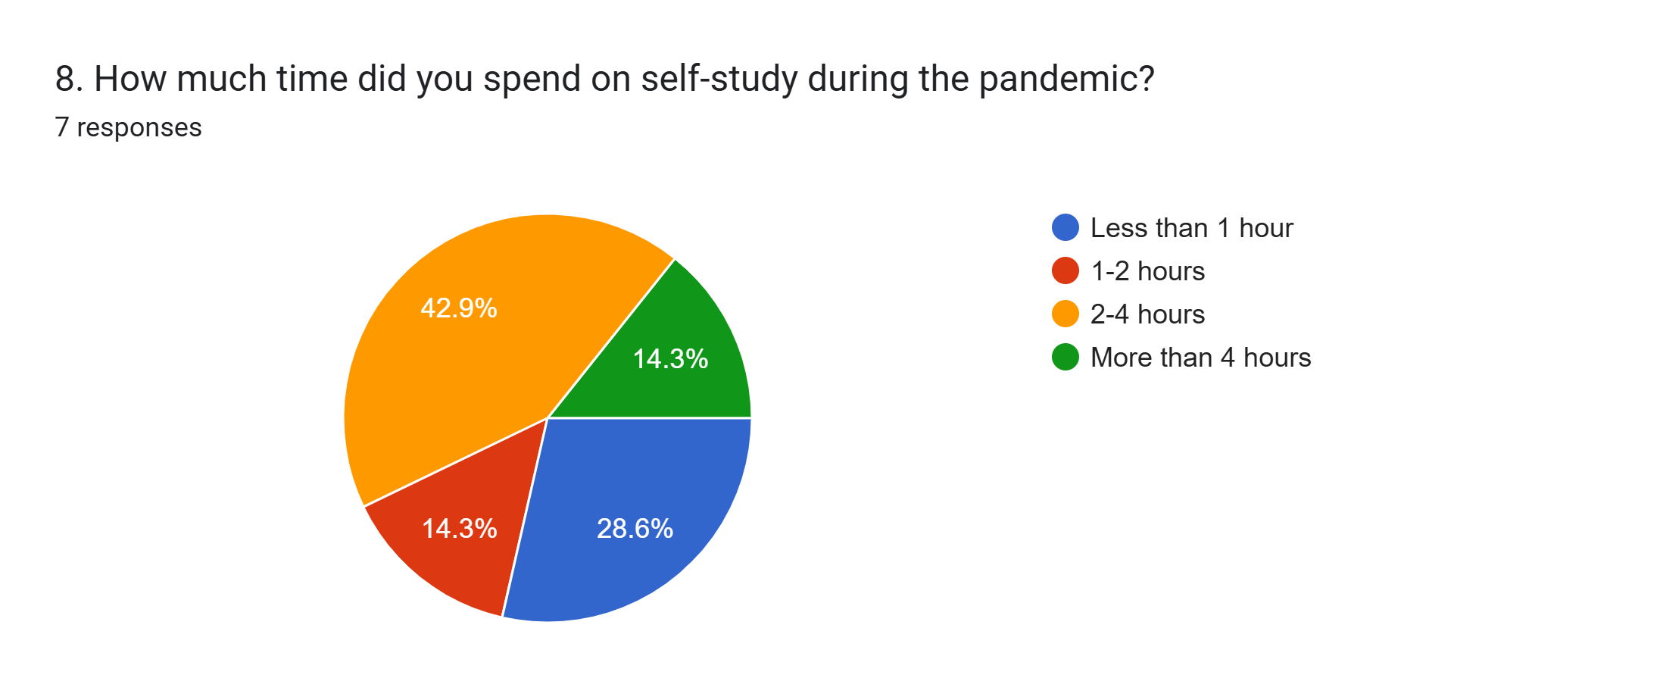
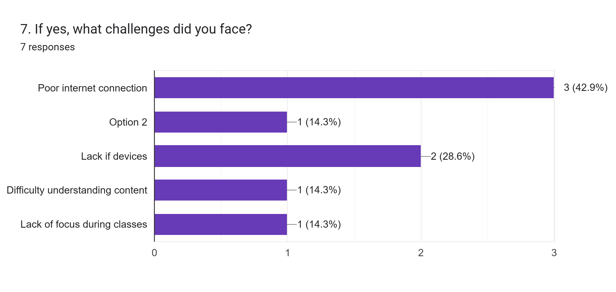
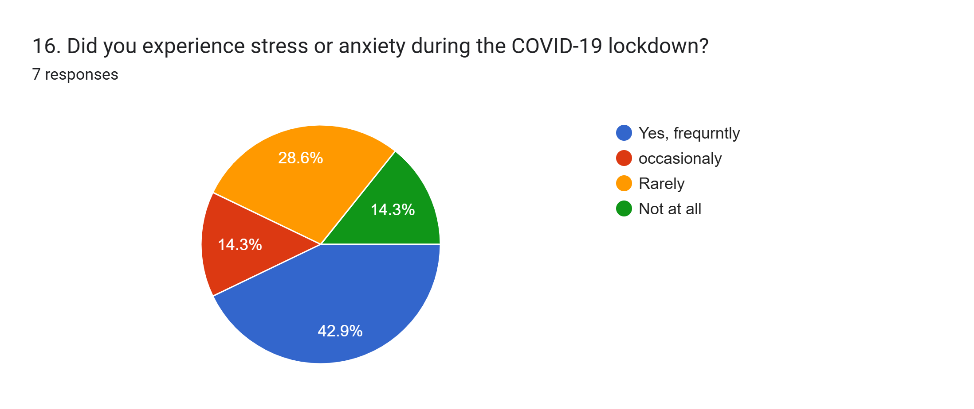

Key Insights from the Survey
Content:
Overview:
Total Respondents: 7
Purpose: To analyze how COVID-19 impacted students' education, social life, and mental health.
Key Findings:
Education:
42.9% faced challenges with online classes.
Average self-study time: 2-4hours/day.
Social Life:
57.1% felt socially isolated.
42.9% stayed connected via social media.
Mental Health:
71.4% experienced stress or anxiety.
57.1% spend time on fitness or physical activities during the lockdown.

